Slide 1

Digital Portfolio
STUDENT NAME: K.Manikandan
REGISTER NO AND NMID: 212400955/5C76035F71BCABAD949C176AC3ABFE
DEPARTMENT: BCA
COLLEGE: PRINCE SHRI VENKATESWARA ART’S AND SCIENCE COLLEGE COLLEGE/ MADRASUNIVERSITY
1
Notes:
1

Slide 2

MY PORTFOLIO
2

Slide 3



AGENDA
Problem Statement
Project Overview
End Users
Tools and Technologies
Portfolio design and Layout
Features and Functionality
Results and Screenshots
Conclusion
Github Link
3/21/2024 Annual Review
3

Slide 4

PROBLEM STATEMENT
1. About Me – More details about your background, skills, and goals.2. Skills – A section with listed skills (maybe progress bars or cards).3. Projects – A portfolio/gallery of your academic or personal projects.4. Certifications – You already linked IBM certification, maybe add more.5. Contact Form – Instead of only email link, an embedded form (HTML/JS).
4

Slide 5

PROJECT OVERVIEW
🔹 IntroductionAn HTML Portfolio is a personal website created using HTML, CSS, and sometimes JavaScript to showcase an individual’s skills, projects, achievements, and contact information. It acts as a digital resume and online presence for students, professionals, or freelancers.---🔹 ObjectivesTo present personal and professional information in a structured and attractive way.To highlight projects, skills, and achievements.To provide an interactive and responsive design for better user experience.To allow recruiters, teachers, or clients to quickly view your work.
5

Slide 6

WHO ARE THE END USERS?
Employers / Recruiters → Review the portfolio to assess skills, creativity, and suitability for a job.Clients / Customers → Use it to decide whether to hire you for a project or purchase services.Teachers / Professors / Evaluators → In academic settings, they evaluate student portfolios for grading and assessment.Peers / Colleagues → May review for collaboration, feedback, or team projects.Investors / Stakeholders → In business portfolios, they assess company performance and growth potential.General Audience / Public → If the portfolio is public (e.g., on a website), anyone interested in your work or brand may view it.
6

Slide 7

TOOLS AND TECHNIQUES
1. HTML5 – Structure of the portfolio (headings, sections, navigation).2. CSS3 – Styling (colors, fonts, layouts, transitions, animations).3. JavaScript – Adds interactivity (sliders, animations, form validation).4. Frameworks & LibrariesBootstrap / Tailwind CSS – For responsive design.jQuery – Simplifies JavaScript DOM manipulation (optional).GSAP / AOS – For smooth scroll animations.5. Version Control – Git & GitHub (to store and share your portfolio).6. Code Editor – VS Code, Sublime Text, or Atom.7. Design Tools – Figma / Canva / Photoshop (to design layout and graphics).8. Icons & Fonts – Font Awesome, Google Fonts.9. Deployment Tools – GitHub Pages, Netlify, or Vercel to host online
7

Slide 8
POTFOLIO DESIGN AND LAYOUT
Suggest a layout idea (sections, structure, flow)?Show you a sample design in HTML/CSS?Or give creative design inspirations (color schemes, typography, UI/UX trends)?
8

Slide 9
FEATURES AND FUNCTIONALITY
Responsive Design – Works smoothly on desktop, tablet, and mobile.Clean Layout – Minimal, professional design with easy navigation.About Section – Brief introduction with personal details and background.Projects Showcase – Displays projects with images, descriptions, and links.Skills Section – Lists technical and soft skills with progress bars or icons.Resume Download – Option to download CV in PDF.Contact Section – Email, phone, or contact form integration.Social Media Links – Quick links to LinkedIn, GitHub, Instagram, etc.Animations/Transitions – Smooth hover effects and scrolling animations.SEO Friendly – Optimized titles, metadata, and keywords for visibility.

Slide 10
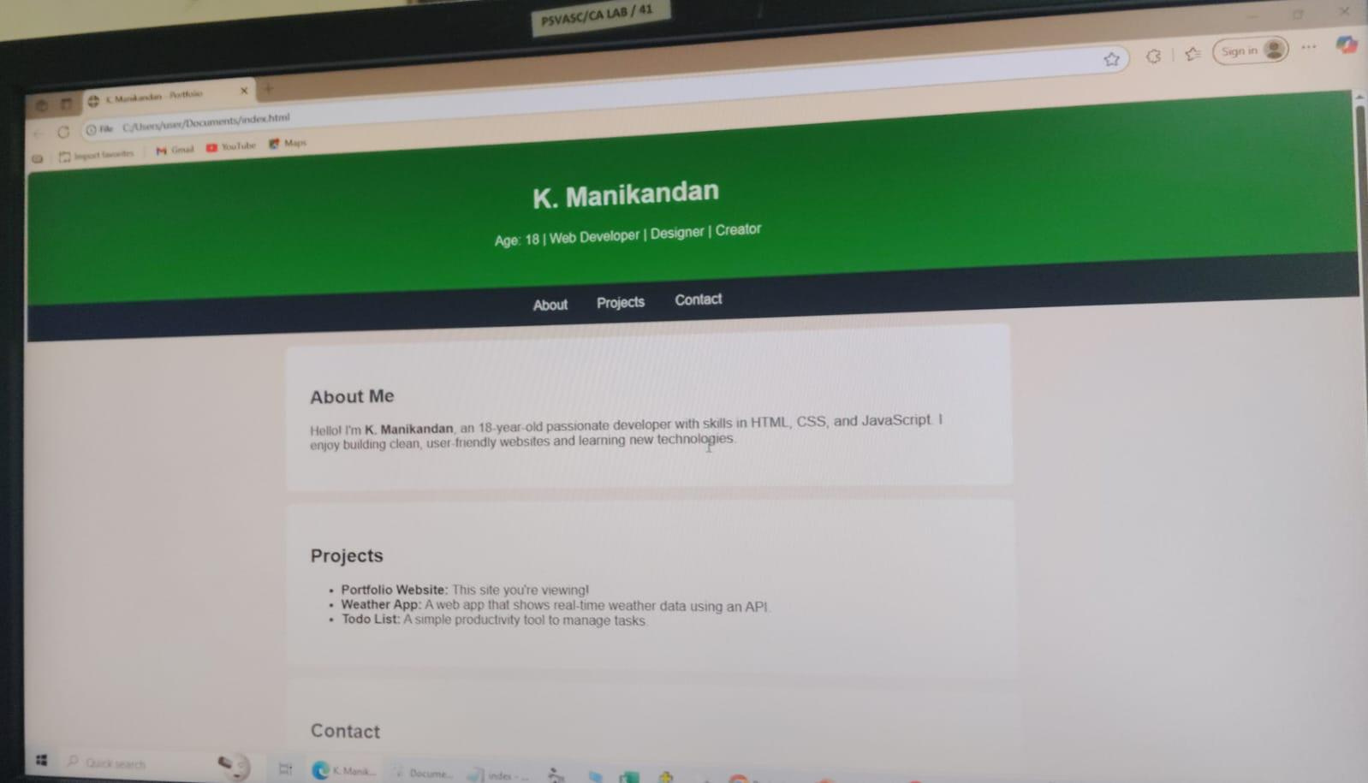

RESULTS AND SCREENSHOTS
3/21/2024 Annual Review
10

Slide 11
CONCLUSION
This portfolio webpage is a simple, stylish, and functional personal site designed with a dark theme and thunder-lightning effect to give a unique visual appeal. It has a sticky navigation bar with links for certification and contact, a hero section that introduces you, and a footer with an auto-updating year. The combination of clean layout, responsive design, interactive hover effects, and background animation makes it both professional and visually engaging while staying minimal and easy to navigate.
11

